Slide 1
Data Science and Engineering Methods and Tools Final Project Presentation (Fall-2021) Diabetic prediction end to end application
Presented By: Ayush Joshi

Slide 2
Introduction
We have created a model to predict weather or not a patient is Diabetic
It is a classification problem
We will be using Random Forest Classifier to Train, Test and predict the result

Slide 3
Steps to run the app
To run the app after installing required libraries
1) open the anaconda power shell command prompt,
2) go to the location where app.py and csv file is located
3) run the command in power shell -> streamlit run app.py
4) The app will start in the browser, it will take some time
5) I have attach the screenshot of terminal in the ppt as well on the next slide.

Slide 4
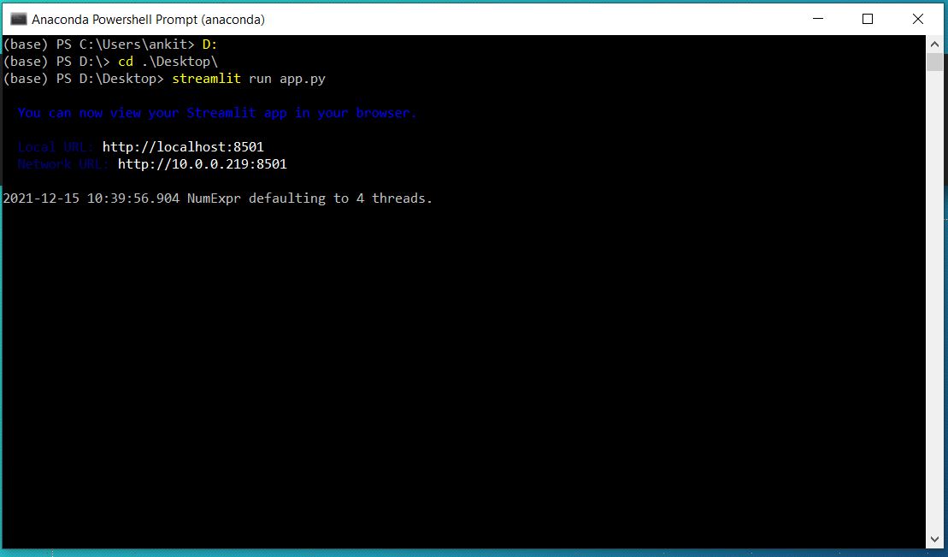
Run the app in browser

Slide 5
Random Forest Classifier
Random forest, like its name implies, consists of a large number of individual decision trees that operate as an ensemble. Each individual tree in the random forest spits out a class prediction and the class with the most votes becomes our model’s prediction

Slide 6
Data set
We are using “Pima Indians Diabetes Database from Kaggle”
Our data set will contains 8 features :
Pregnancies
Glucose
Blood Pressure
Skin Thickness
Insulin
BMI
Diabetes Pedigree Function
Age

Slide 7
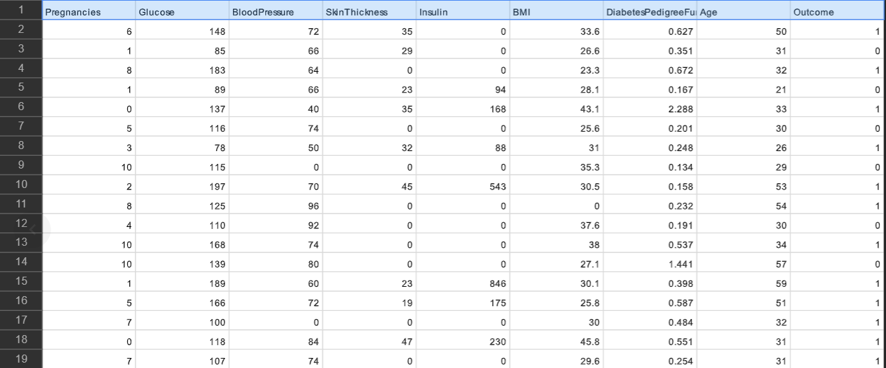
Analyze our data from csv
We can see columns as out features and the last column is outcome, where 1 means patient is Unhealthy and 0 means patient is healthy

Slide 8
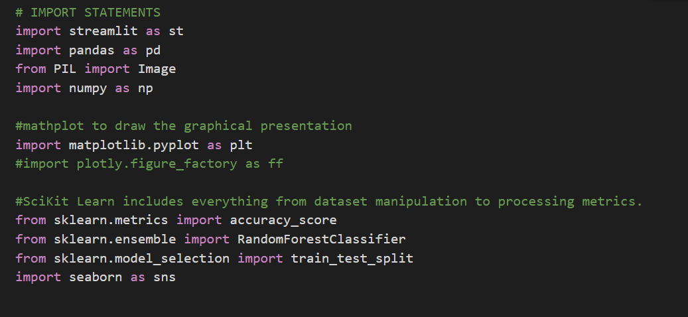
Import required libraries

Slide 9

Import data from csv file
Next we will import out data from the csv file using pandas

Slide 10
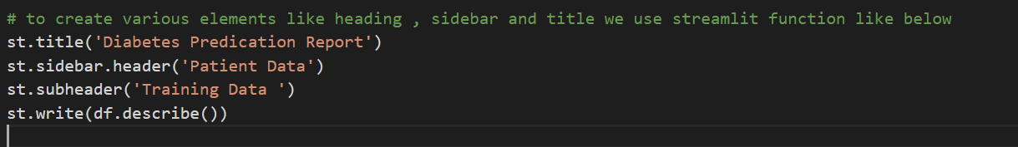
Create corresponding UI component
Now we will create various UI element for our features

Slide 11
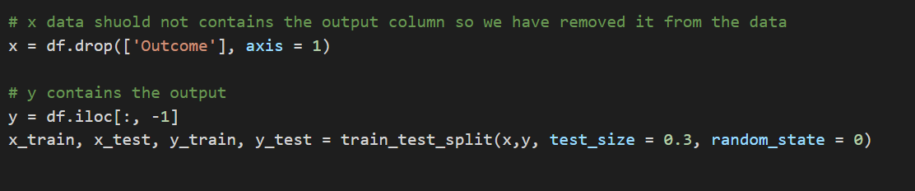
Store input and output values

Slide 12
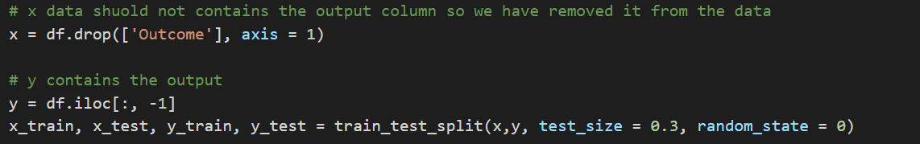
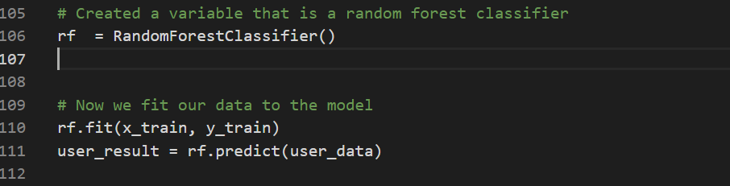
Fit the data into the model

Slide 13
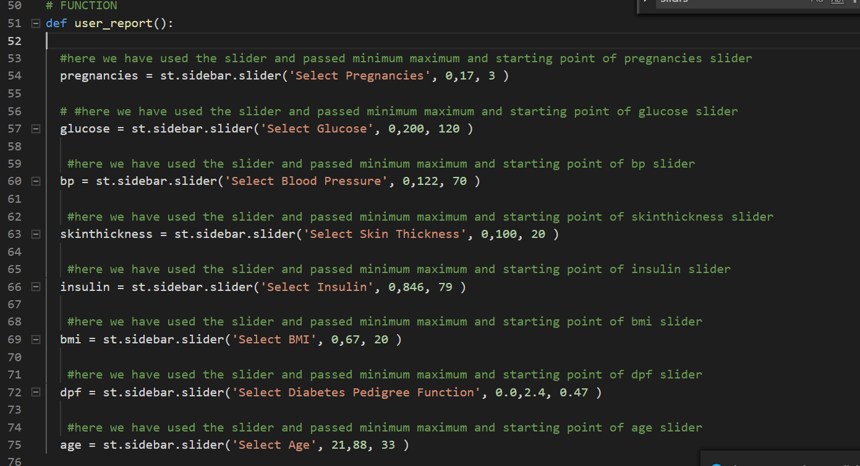
Create function to set the feature values

Slide 14
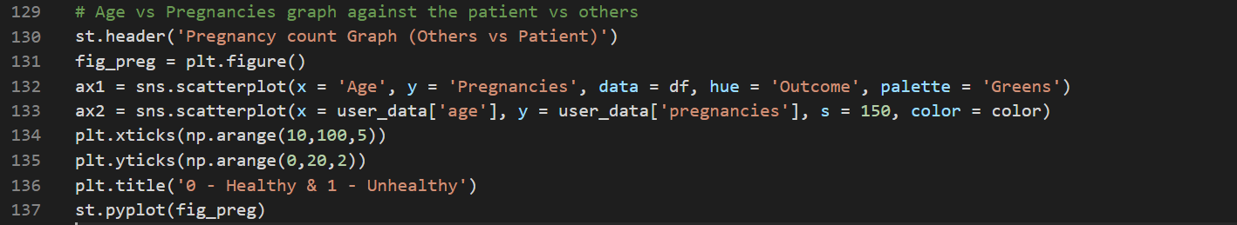
Plot the graph with age against various feature

Slide 15
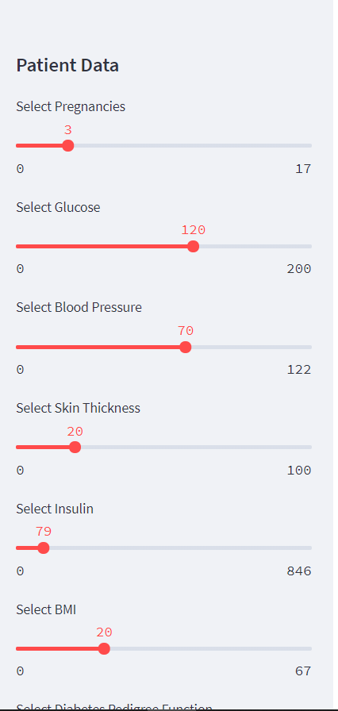
Input values of patient data from UI

Slide 16
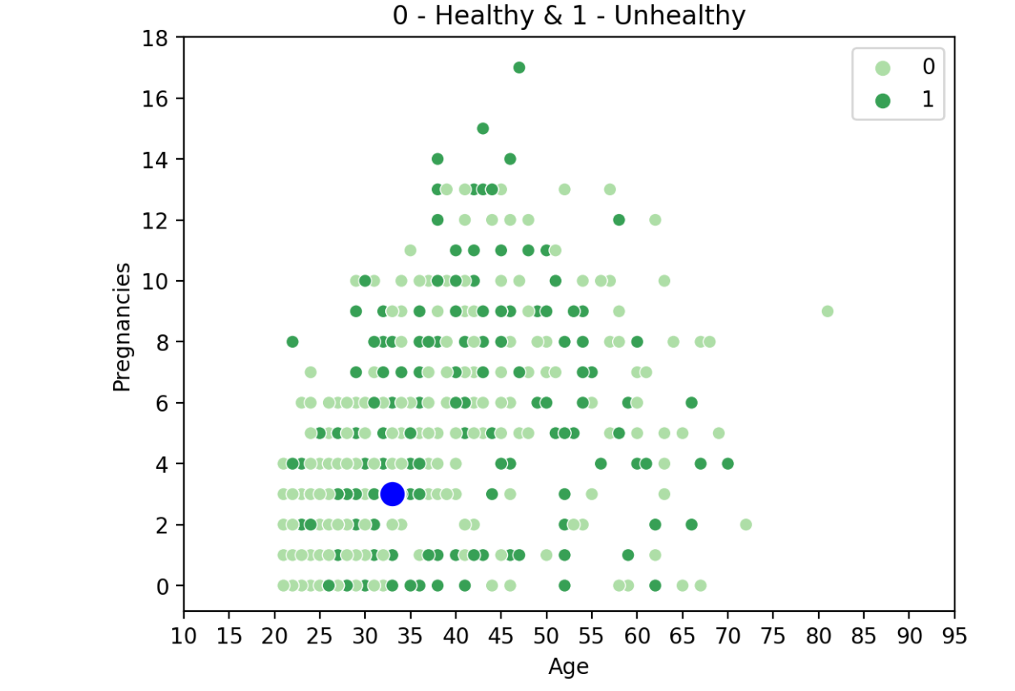
Analyze real-time data using graph plot on UI

Slide 17
References
https://www.kaggle.com/uciml/pima-indians-diabetes-database

Slide 18
Thank you

